Slide 1
CS577 Group Project Explore the Application of Diffusion Model in Video Content Creation
Haiyun Xia Yu Li Haichen Pang

Slide 2
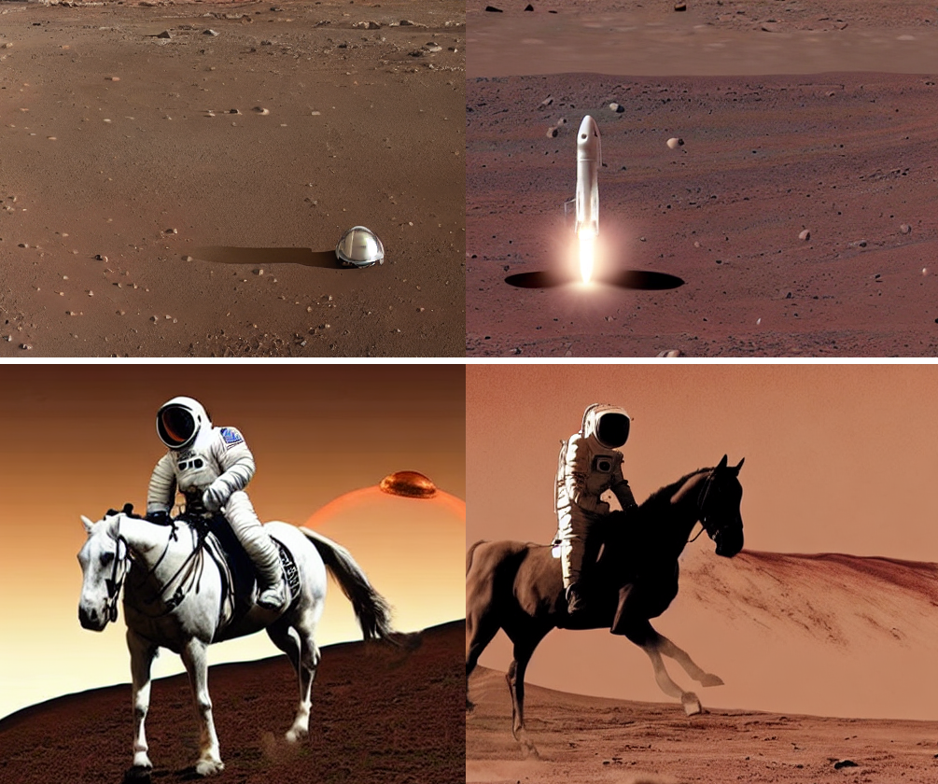
Problem description and introduction
The content landscape has witnessed a surge in video production. However, this surge still necessitates substantial creator involvement throughout the entire content creation process.
Inspired by the transfor- mative potential of Diffusion Models, we’ve embarked on a quest to explore the feasibility of generating videos from text, much like the concept of text-to-image generation.
“We hope to implement an application that can automatically generate similar pictures based on text descriptions. These generated pictures can be connected to form a multimedia video.”

Slide 3
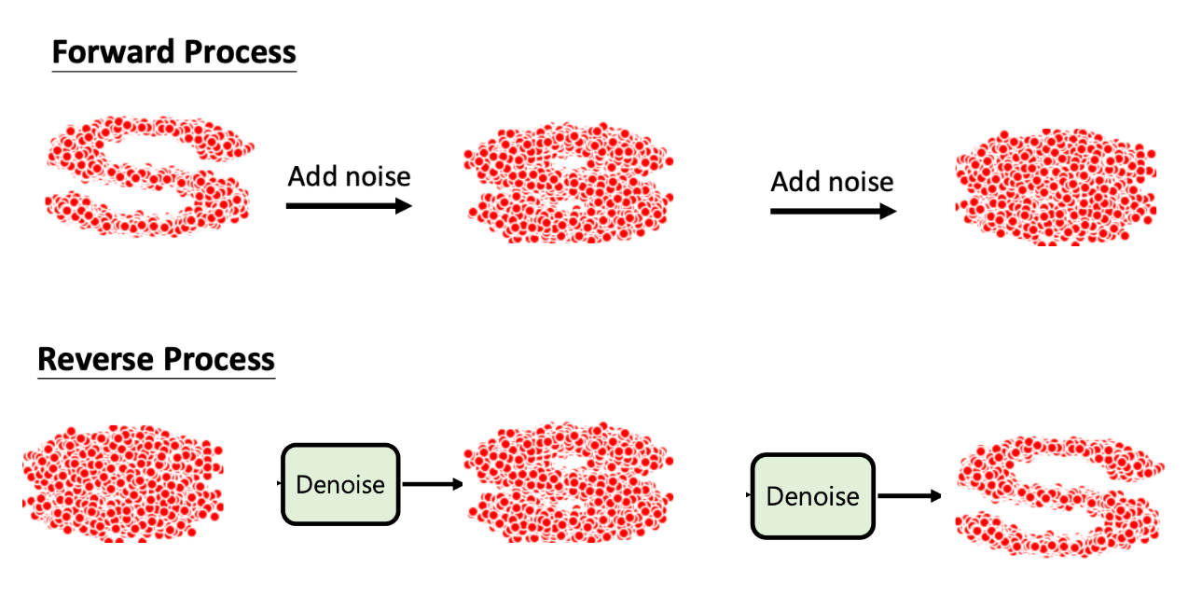
2. Diffusion Model
Base Idea
1. Forward diffusion process: adds Gaussian noise to the image until end up with pure noise.
2. Reverse diffusion process: train a neural network to gradually denoise from pure noise to a real image.

Slide 4
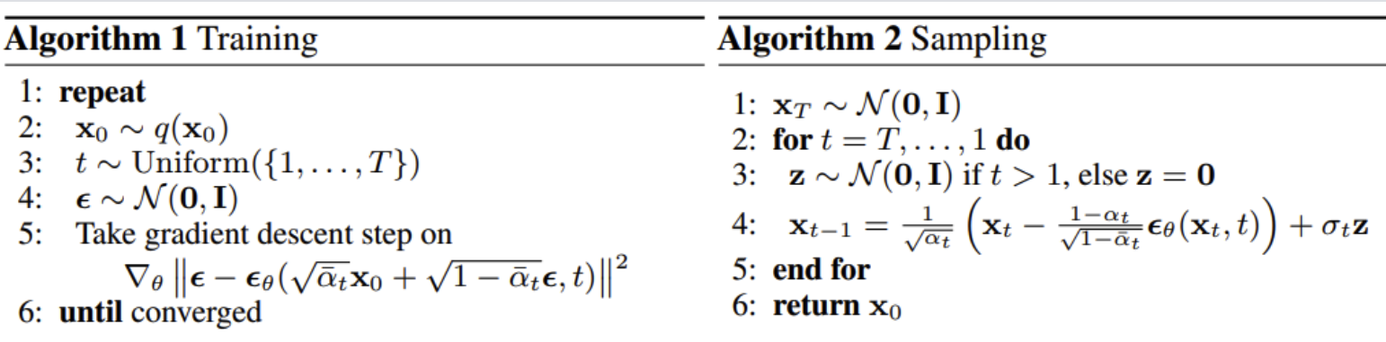
Psudo Code Algorithm
2. Diffusion Model

Slide 5
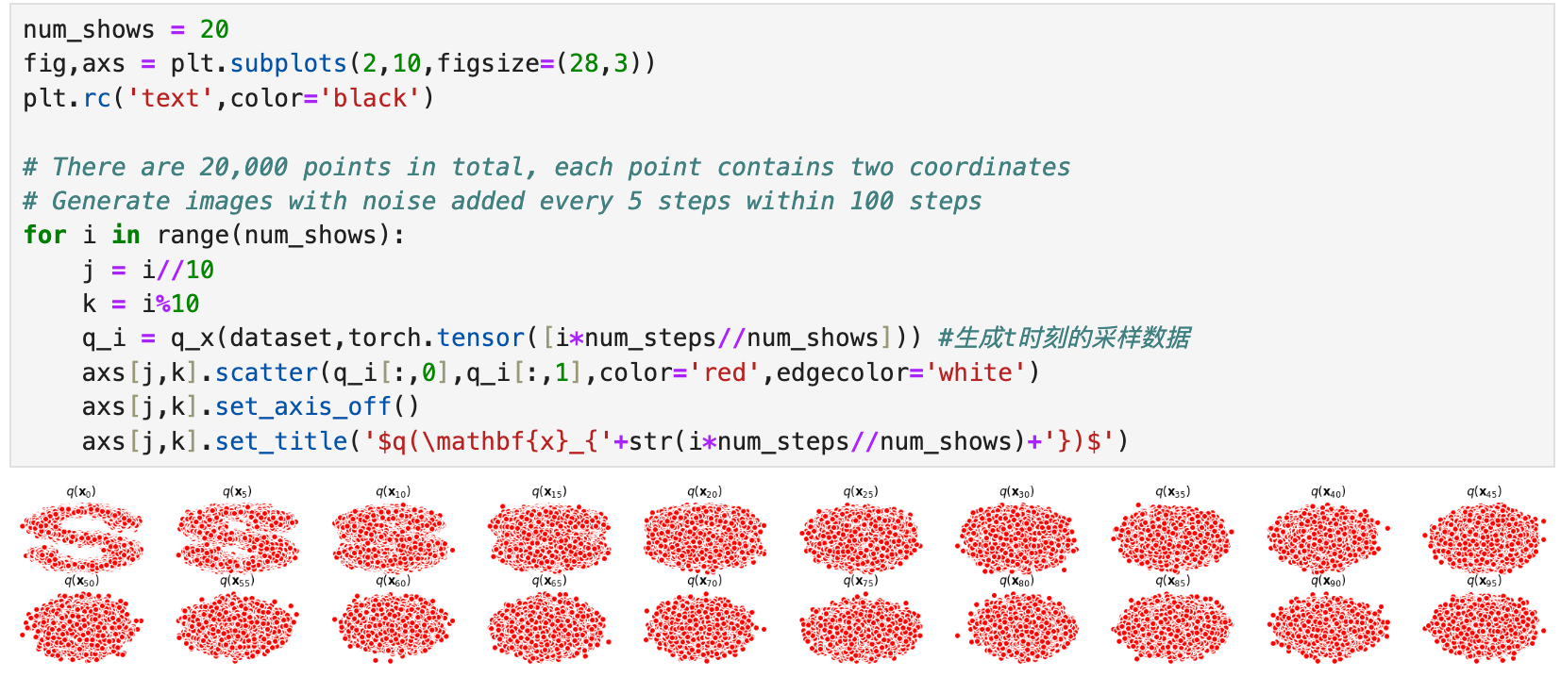
Code implementation
2. Diffusion Model

Slide 6
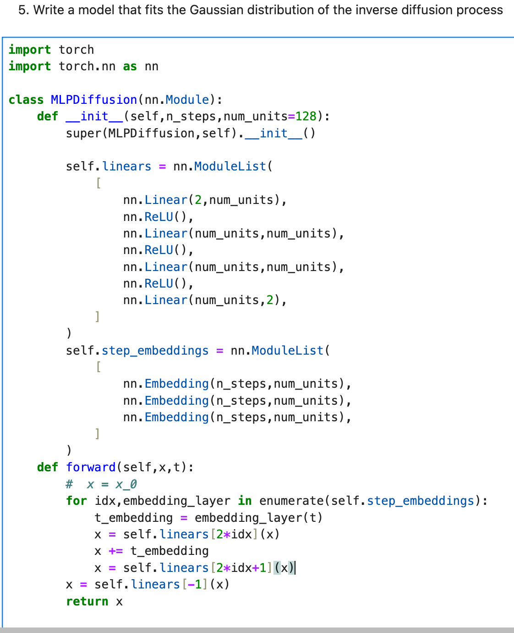
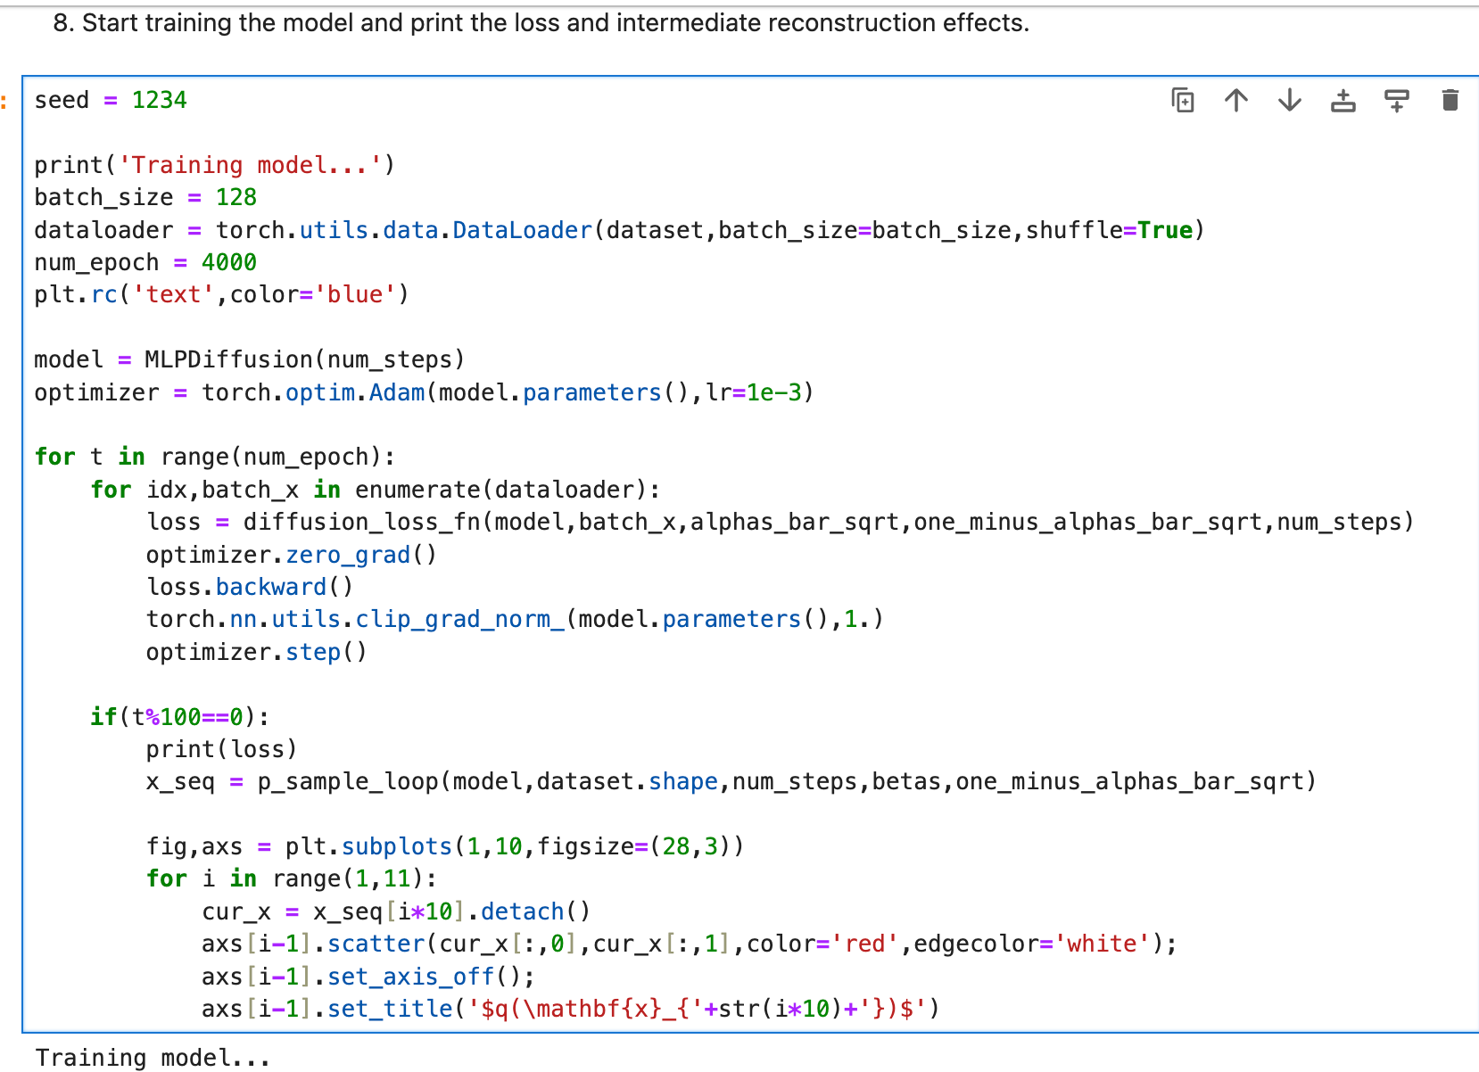
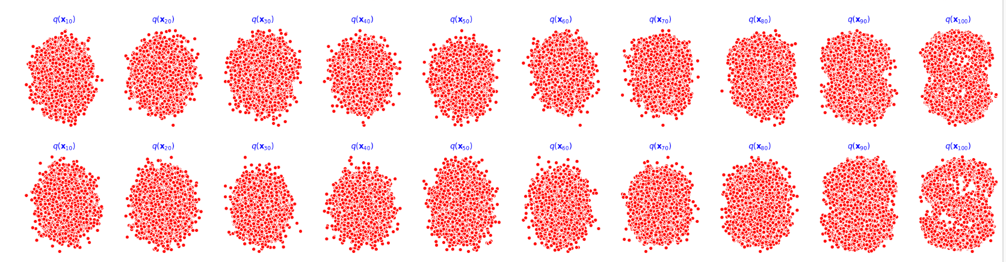
2. Diffusion Model

Slide 7
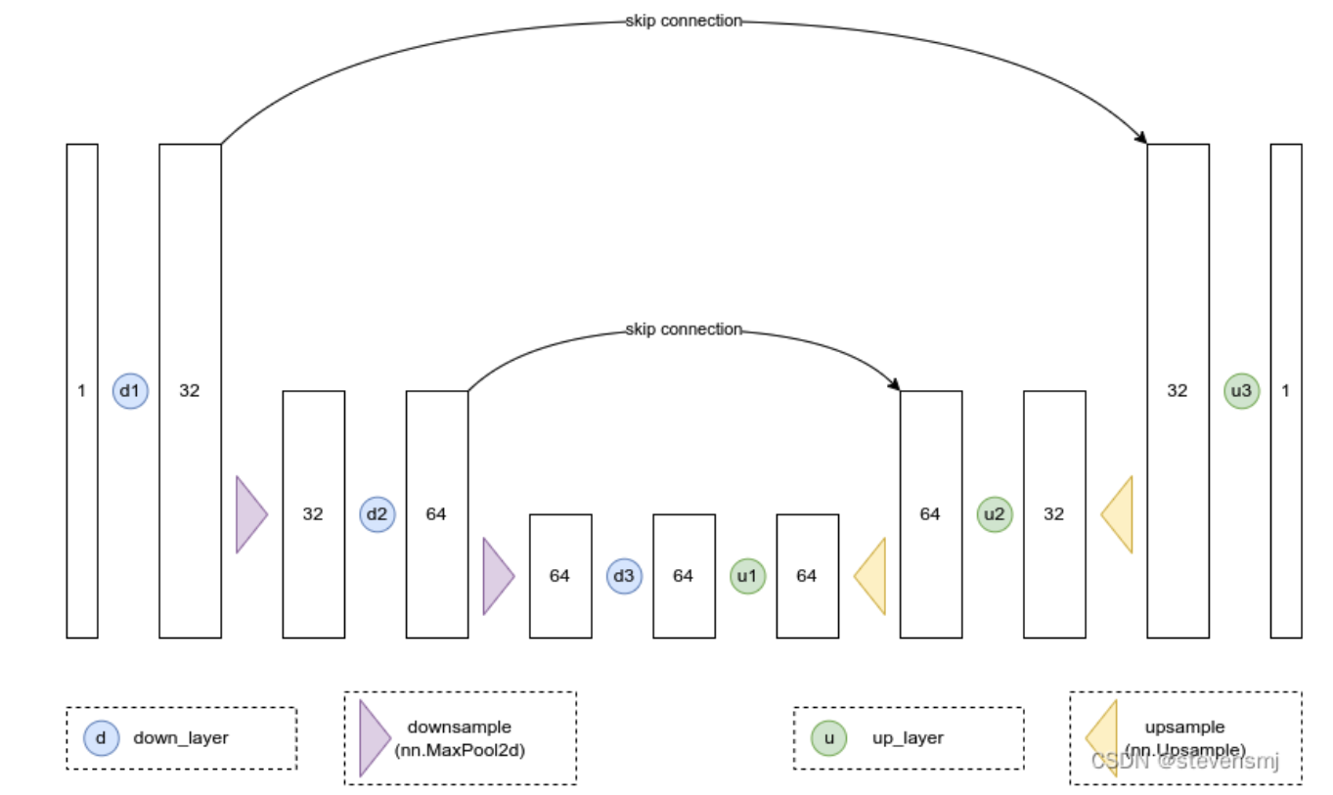
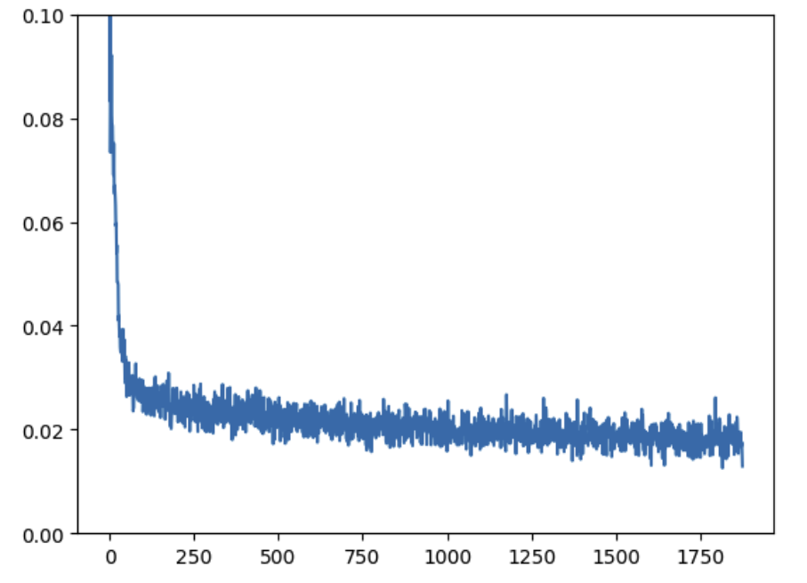
Using MNIST dataset and BasicUNet to verify the training effect of the diffusion model
2. Diffusion Model

Slide 8
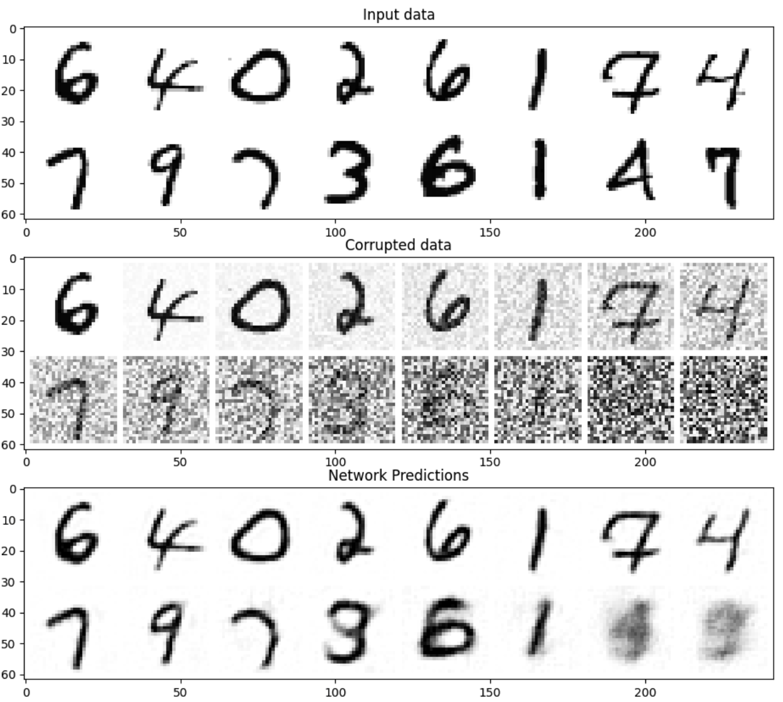
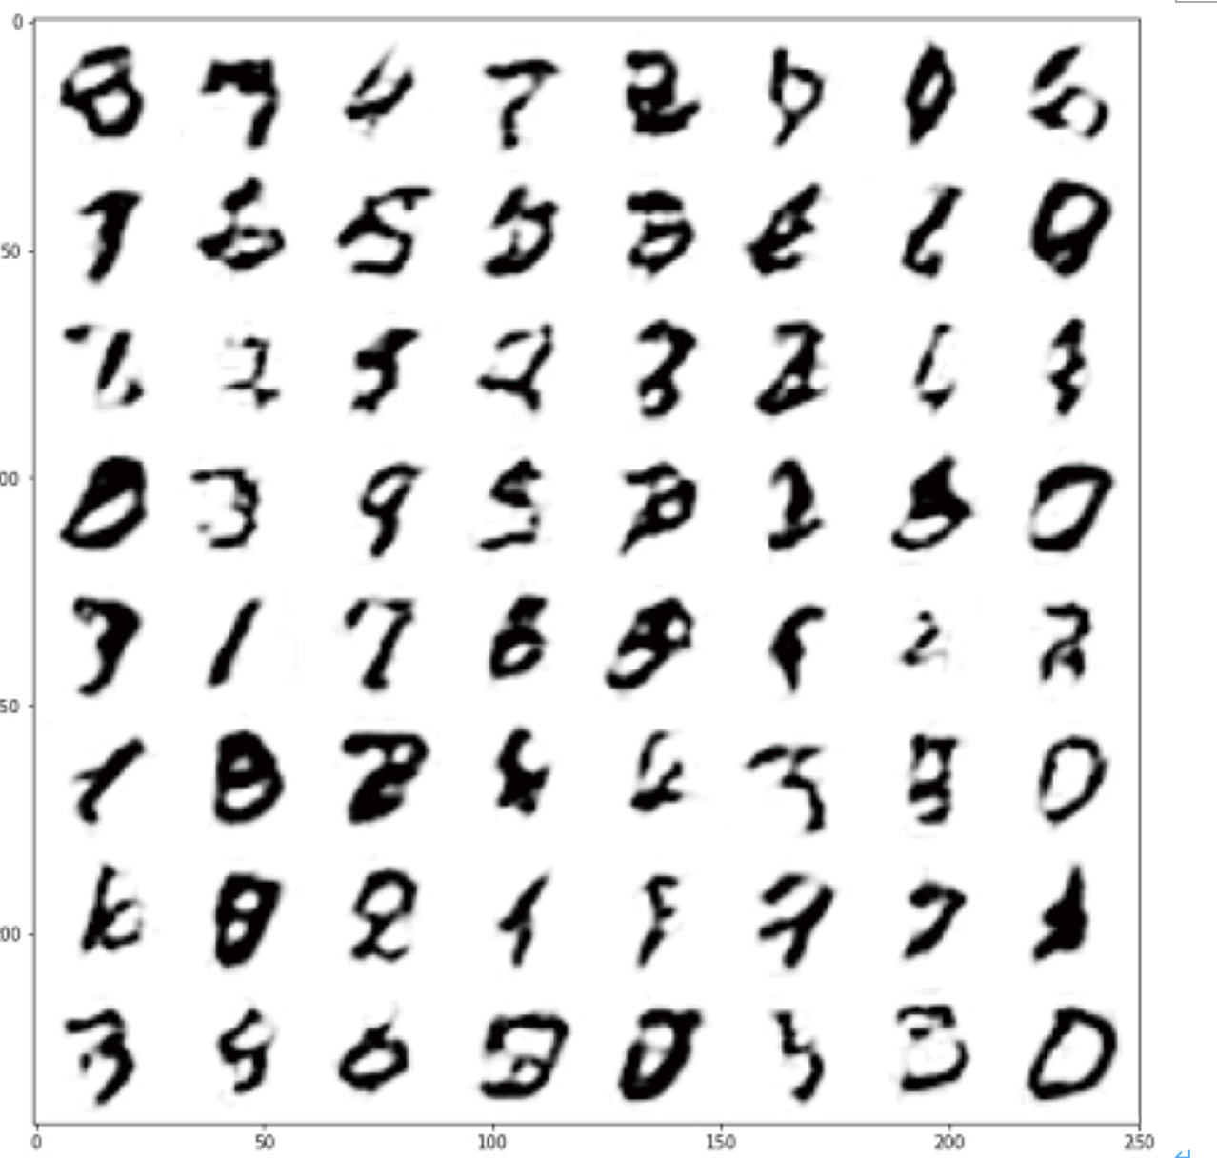
Using MNIST dataset and BasicUNet to verify the training effect of the diffusion model
2. Diffusion Model
As shown in the figure above, for inputs with low amounts of noise, the model's predictions are quite good.
However, for inputs with a high amount of noise, the information the model is able to obtain starts to decrease. When amount = 1, the model will output a vague prediction that is very close to the mean of the data set.

Slide 9
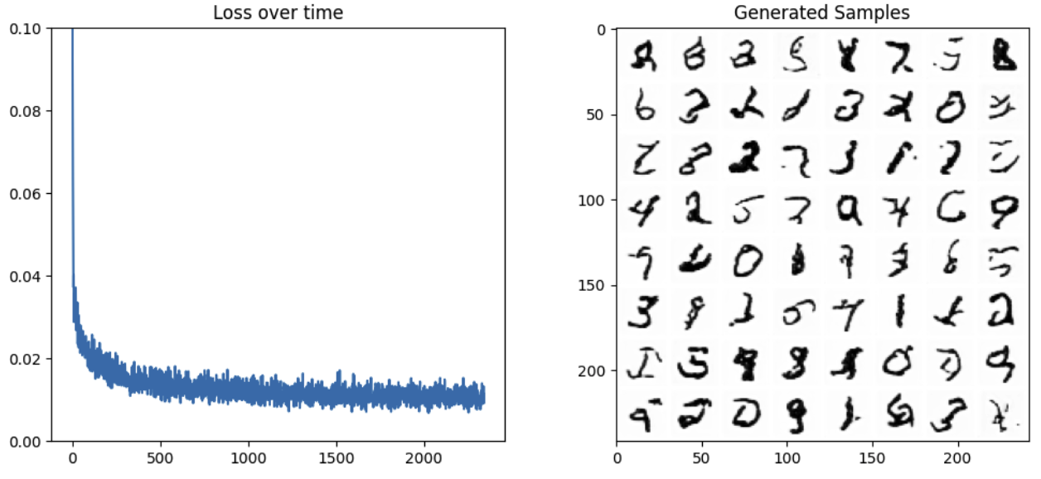
Model comparison: Using MNIST dataset and UNet2DModel from the Diffusers library , Judging from the images and loss curves of the generated samples, this model is much better than the basic model. Losses are also reduced even more.
2. Diffusion Model

Slide 10
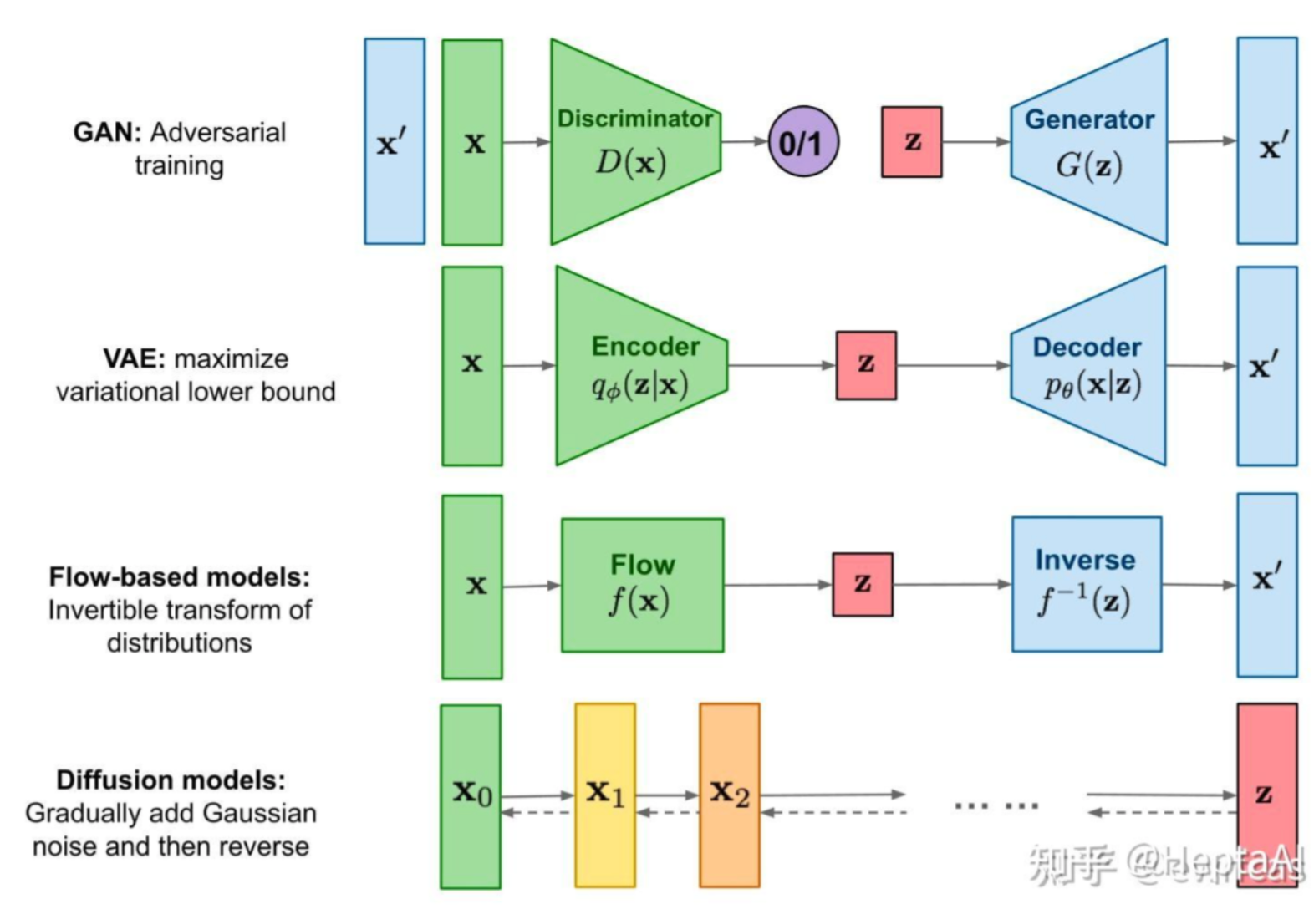
2. Diffusion Model
The difference between VAE and Diffusion
VAE is essentially a gradient-based
encoder-decoder architecture.
Diffusion is essentially an SDE/Markov architecture.
Both define Gaussian distribution as latent variables, but VAE will serve as a priori condition (variational prior), while diffusion will serve as a stationary distribution similar to a Markov chain with variational posterior.
image source：https://zhuanlan.zhihu.com/p/525106459
Notes:
The difference between VAE and Diffusion
VAE is essentially a gradient-based encoder-decoder architecture. The encoder is used to learn the mean and variance of Gaussian distribution. The decoder uses variational posteriors to learn generation capabilities. The mapping of standard Gaussian to data samples is self-defined.
Diffusion is essentially an SDE/Markov architecture. Although it also draws on the forward propagation/back propagation concepts of neural networks, it is not based on differentiable gradients.
Both define Gaussian distribution as latent variables, but VAE will serve as a priori condition (variational prior), while diffusion will serve as a stationary distribution similar to a Markov chain with variational posterior.

Slide 11
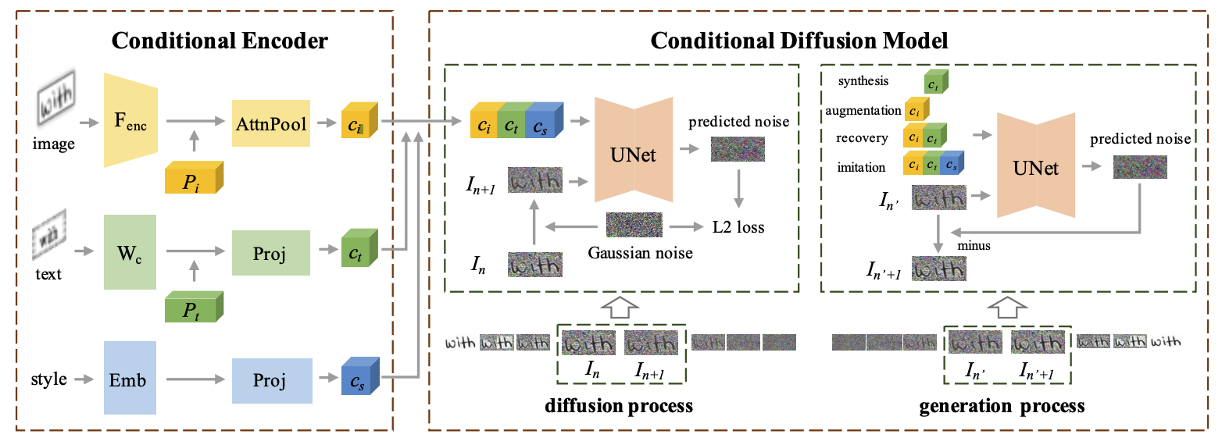
Text to image generation need more complex models
3. Stable Diffusion
The biggest problem with the diffusion model is that it is extremely "expensive" in both time and economic costs.
If we want to generate an image of size 1024 * 1024, U-Net will use noise of size 1024 * 1024 and generate the image from it. The amount of calculation required to do one-step diffusion here is very large, not to mention the need to iterate multiple times until it reaches 100%.

Slide 12
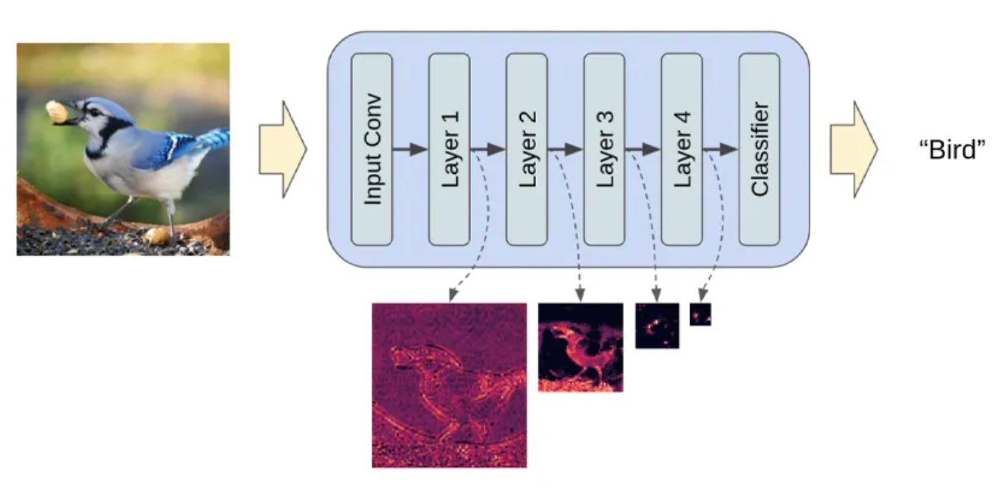
Latent Diffusion model
3. Stable Diffusion
The Latent Diffusion model released in 2021 gives a different approach. The Latent Diffusion model does not operate directly on the image, but in the latent space.
By encoding the original data into a smaller space, U-Net can add and remove noise on the low-dimensional representation.
Lantent Space
Notes:
潜在空间简单的说是对压缩数据的表示。所谓压缩指的是用比原始表示更小的数位来编码信息的过程。比如我们用一个颜色通道（黑白灰）来表示原来由RGB三原色构成的图片，此时每个像素点的颜色向量由3维变成了1维度。维度降低会丢失一部分信息，然而在某些情况下，降维不是件坏事。通过降维我们可以过滤掉一些不太重要的信息你，只保留最重要的信息。
假设我们像通过全连接的卷积神经网络训练一个图像分类模型。当我们说模型在学习时，我们的意思是它在学习神经网络每一层的特定属性，比如边缘、角度、形状等……每当模型使用数据（已经存在的图像）学习时，都会将图像的尺寸先减小再恢复到原始尺寸。最后，模型使用解码器从压缩数据中重建图像，同时学习之前的所有相关信息。因此，空间变小，以便提取和保留最重要的属性。这就是潜在空间适用于扩散模型的原因。

Slide 13
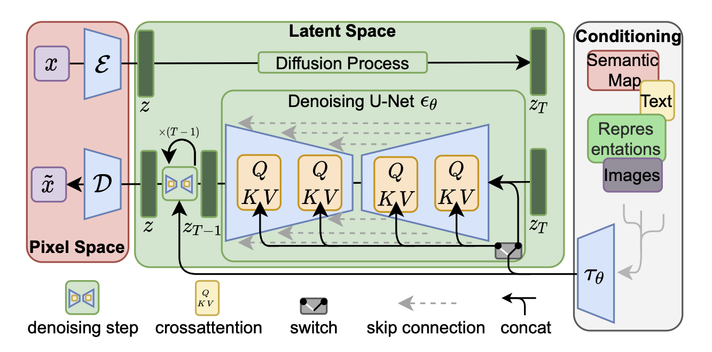
Latent diffusion model introduction (Architecture in the original paper)
3. Stable Diffusion
The "Latent Diffusion Model" combines the perception ability of GAN, the detail preservation ability of the diffusion model, and the semantic ability of the Transformer to create a generation model that is more robust and efficient than all the above models.
Notes:
“潜在扩散模型”（Latent Diffusion Model）将GAN的感知能力、扩散模型的细节保存能力和Transformer的语义能力三者结合，创造出比上述所有模型更稳健和高效的生成模型。与其他方法相比，Latent Diffusion不仅节省了内存，而且生成的图像保持了多样性和高细节度，同时图像还保留了数据的语义结构。
这里让我们来看一下潜在扩散模型的完整工作流程：首先需要训练好一个自编码模型（AutoEncoder，包括一个编码器 E 和一个解码器 D ）。这样一来，我们就可以利用编码器对图片进行压缩，然后在潜在表示空间上做diffusion操作，最后我们再用解码器恢复到原始像素空间即可，论文将这个方法称之为感知压缩（Perceptual Compression）。
The "Latent Diffusion Model" combines the perception ability of GAN, the detail preservation ability of the diffusion model, and the semantic ability of the Transformer to create a generation model that is more robust and efficient than all the above models. Compared with other methods, Latent Diffusion not only saves memory, but also generates images that maintain diversity and high detail, while the images also retain the semantic structure of the data.
Here let us take a look at the complete workflow of the potential diffusion model: First, we need to train an autoencoding model (AutoEncoder, including an encoder E and a decoder D). In this way, we can use the encoder to compress the image, and then perform a diffusion operation on the potential representation space. Finally, we can use the decoder to restore the original pixel space. The paper calls this method perceptual compression. Compression).

Slide 14
Latent diffusion model introduction (Architecture in the original paper)
3. Stable Diffusion
The complete workflow of the latent diffusion model:
1. Need to train an autoencoding model (AutoEncoder, including an encoder E and a decoder D).
2. And then perform a diffusion operation on the potential representation space.
3. Use the decoder to restore the original pixel space. (The paper calls this method perceptual compression)
Notes:
“潜在扩散模型”（Latent Diffusion Model）将GAN的感知能力、扩散模型的细节保存能力和Transformer的语义能力三者结合，创造出比上述所有模型更稳健和高效的生成模型。与其他方法相比，Latent Diffusion不仅节省了内存，而且生成的图像保持了多样性和高细节度，同时图像还保留了数据的语义结构。
这里让我们来看一下潜在扩散模型的完整工作流程：首先需要训练好一个自编码模型（AutoEncoder，包括一个编码器 E 和一个解码器 D ）。这样一来，我们就可以利用编码器对图片进行压缩，然后在潜在表示空间上做diffusion操作，最后我们再用解码器恢复到原始像素空间即可，论文将这个方法称之为感知压缩（Perceptual Compression）。
The "Latent Diffusion Model" combines the perception ability of GAN, the detail preservation ability of the diffusion model, and the semantic ability of the Transformer to create a generation model that is more robust and efficient than all the above models. Compared with other methods, Latent Diffusion not only saves memory, but also generates images that maintain diversity and high detail, while the images also retain the semantic structure of the data.
Here let us take a look at the complete workflow of the potential diffusion model: First, we need to train an autoencoding model (AutoEncoder, including an encoder E and a decoder D). In this way, we can use the encoder to compress the image, and then perform a diffusion operation on the potential representation space. Finally, we can use the decoder to restore the original pixel space. The paper calls this method perceptual compression. Compression).

Slide 15
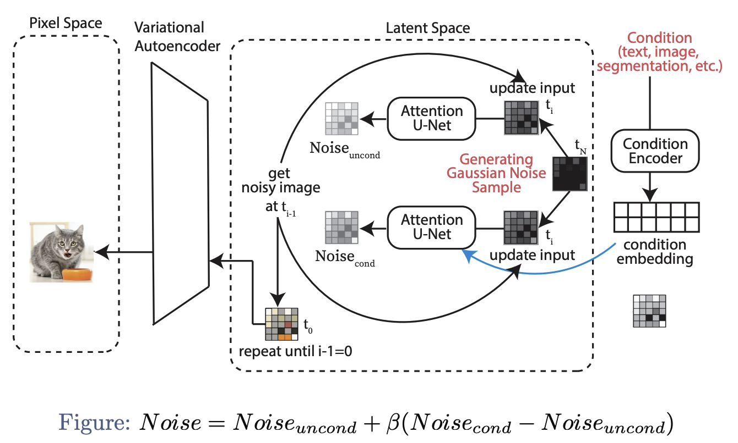
LDMs: New-Image Generation
Notes:
这是关于LDMs 的 New-Image Generation 过程

Slide 16
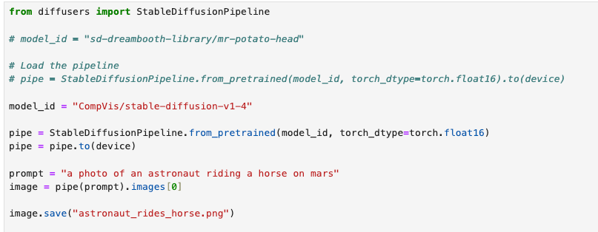
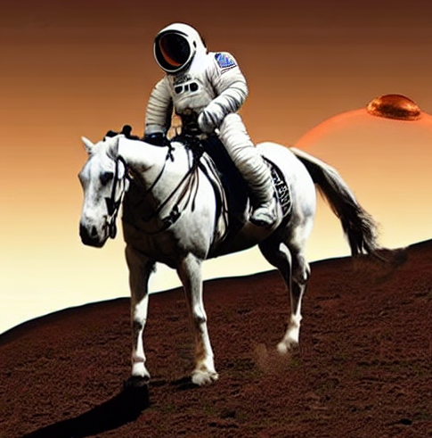
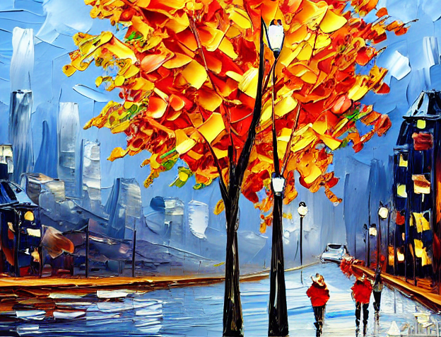
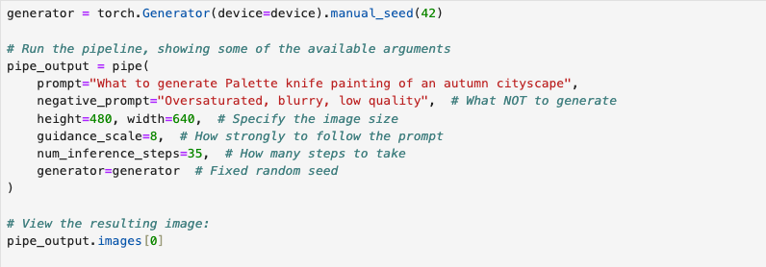
stable diffusion Code practice
Notes:
The underlying working mechanism of Stable Diffusion
Step 1. Enter the prompt word and parse the prompt word: Text Image Encoder CLIP
Step 2. Generate image representation based on prompt word representation: Diffusion process based on U-Net (U-Net + Scheduler)
Step 3. Processing and conversion of image input and output: VAE (the image decoder is responsible for image generation from latent space to pixel space)

Slide 17
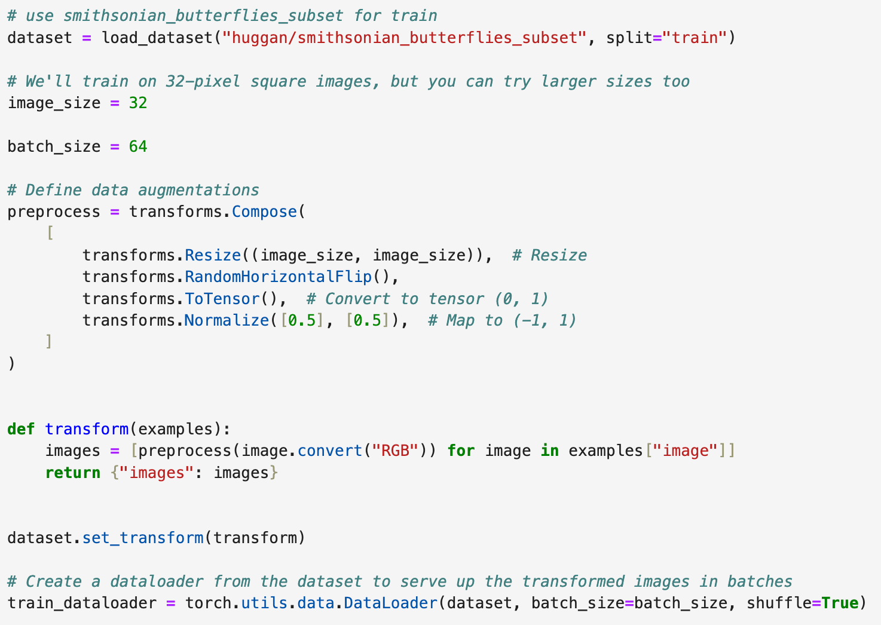
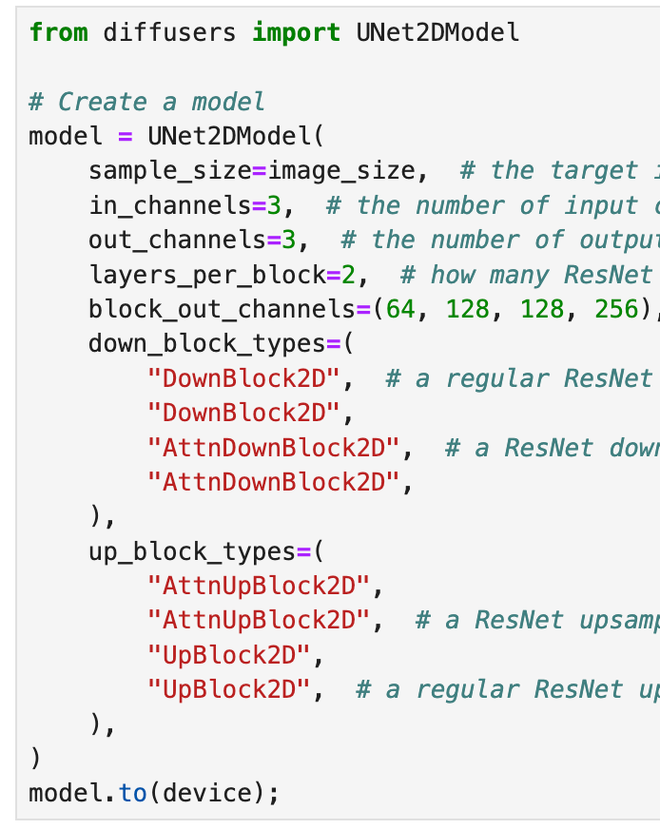
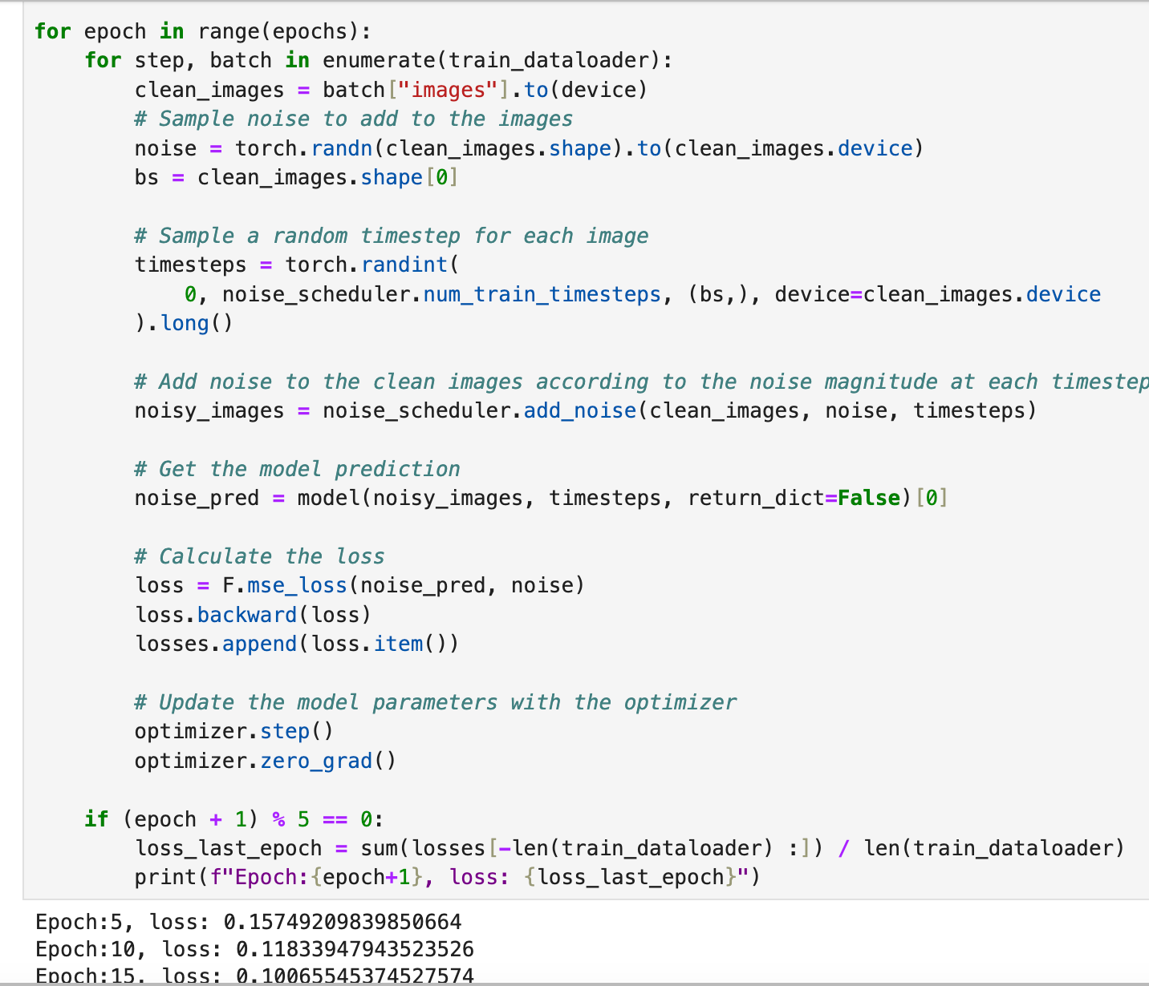
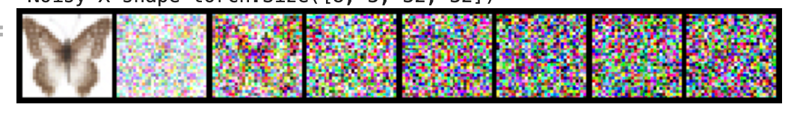
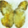
Train diffusion model locally
In order to better understand the diffusion model, principles and methods, we studied relevant information and trained the local diffusion model instead of directly using the trained model.
dataset
Model
train
Notes:
The underlying working mechanism of Stable Diffusion
Step 1. Enter the prompt word and parse the prompt word: Text Image Encoder CLIP
Step 2. Generate image representation based on prompt word representation: Diffusion process based on U-Net (U-Net + Scheduler)
Step 3. Processing and conversion of image input and output: VAE (the image decoder is responsible for image generation from latent space to pixel space)

Slide 18
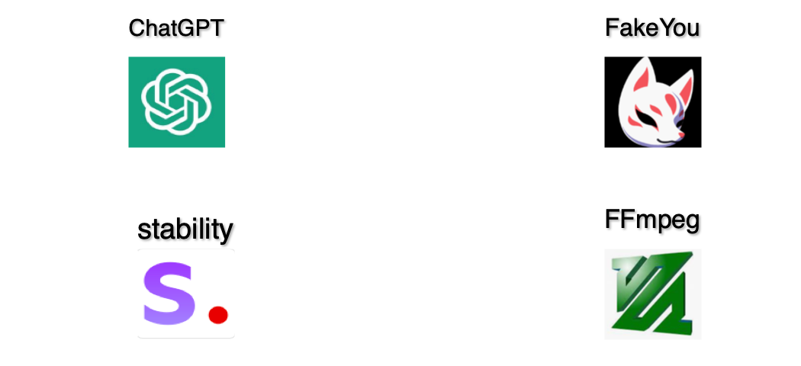
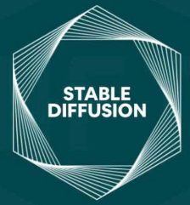
4. Text to video generation using diffusion model
Tools we use
Notes:
stable diffusion

Slide 19
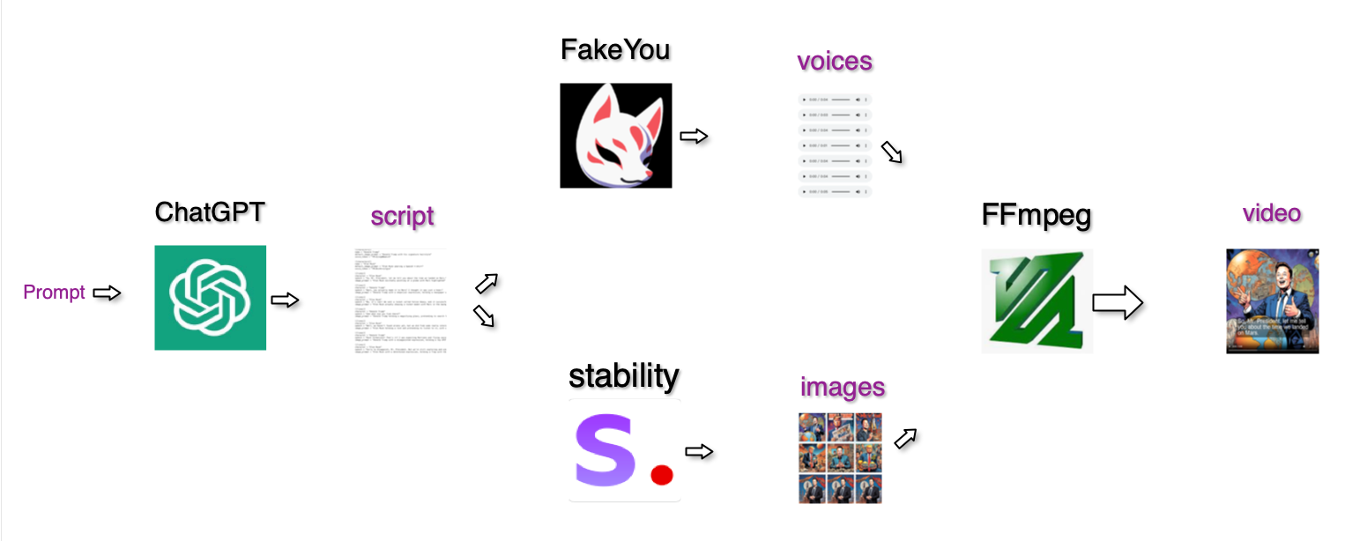
5. How it works
In addition to calling the API to generate, we also locally train to generate pictures and music based on the diffusion model. DEMO has been implemented, refer to the notebook code.
Modified from an open-source project (https://github.com/joshmoody24/sitcom-simulator)

Slide 20
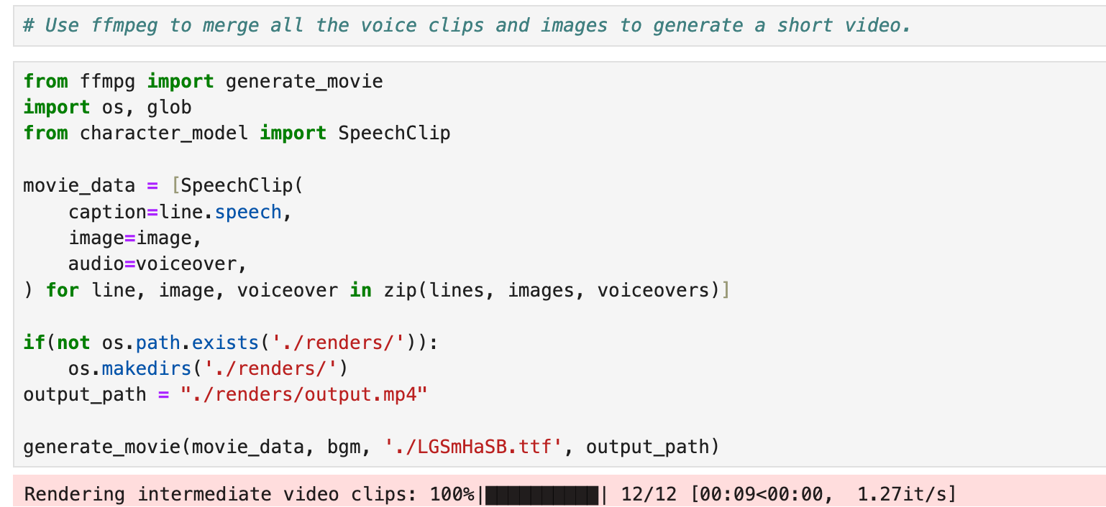
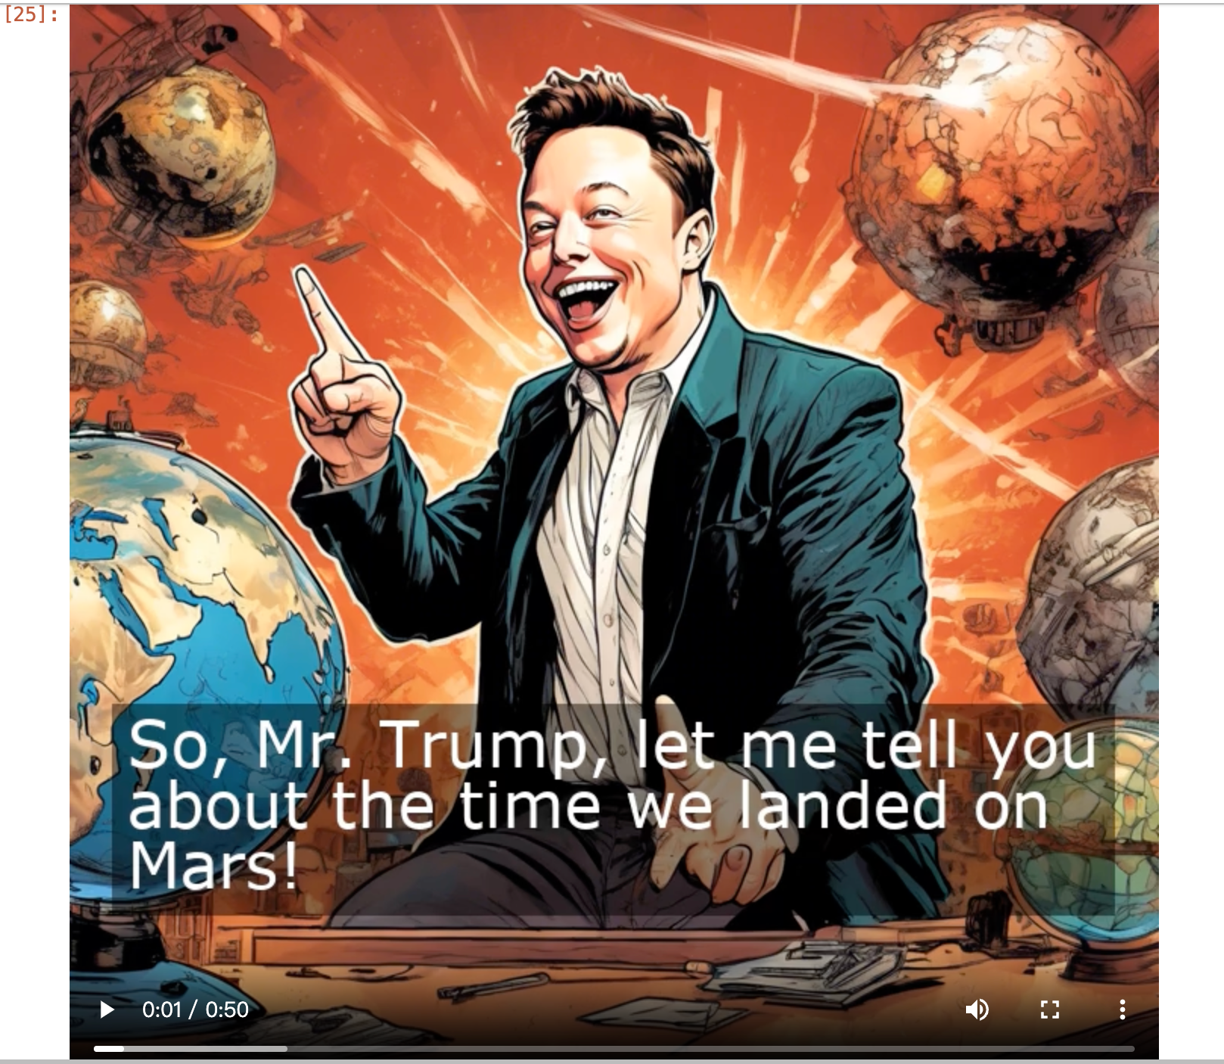
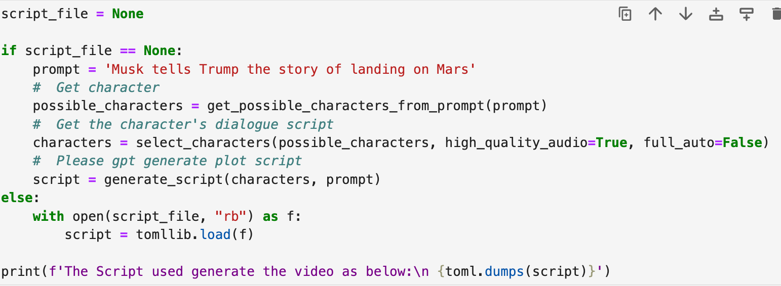
5. How it works
Video generation results.
Modified from an open-source project (https://github.com/joshmoody24/sitcom-simulator)

Slide 21
6. Limitations of this approach
1. Only dialogue-based videos, Limited range of character selection.
2. Encountered sub- stantial challenges when attempting to generate coherent images， only comics type videos can be generated.
3. Although it is possible to control the fineness of the generated images, the entire video cannot be fine-tuned and cannot be controlled at a fine-grained level.
Notes:
While it is possible to generate videos, only dialogue-based videos have limited character selection.虽然能够生成视频，仅基于对话的视频，角色选择范围有限。
Comic book style video.
Although it is possible to control the fineness of the generated images, the entire video cannot be fine-tuned and cannot be controlled at a fine-grained level.
虽然能够控制生成图片的精细度，但整个视频无法微调，无法细粒度控制。

Slide 22
7. What we gained from the whole project
1. Understood the basic principle of the diffusion algorithm.
2. Trained the basic version of the diffusion model locally.
3. Explored an implementation idea for generating videos from text.
Follow-up plan:
we are planning to investigate an alternative approach: directly generating videos using the latent diffusion model.
This involves the intriguing idea of feeding video materials directly into the model, allow it to learn the underlying patterns and dynamics, and subsequently generating videos through reverse inference.
Tips:
Just as we were practicing the project, Meta announced the launch of an AI video editing tool: Emu Video. Just enter the title, image, image and description, and Emu Video can generate a 4-second long animation clip. Stable diffusion video is also has been published.

